Slide 1
Welcome!

Slide 2
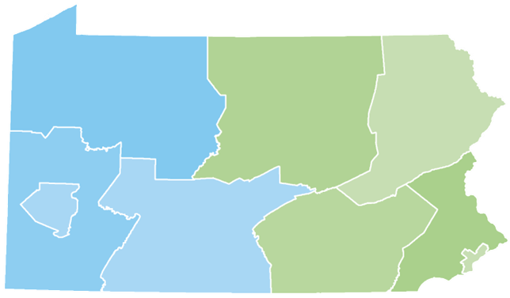
Your Presenter
Ronald Felder
Higher Education Access Partner
Philadelphia Region
PA Higher Education Assistance Agency (PHEAA)
267-294-8204
Ronald.Felder@pheaa.org
Notes:
To be revised by each Access Partner

Slide 3




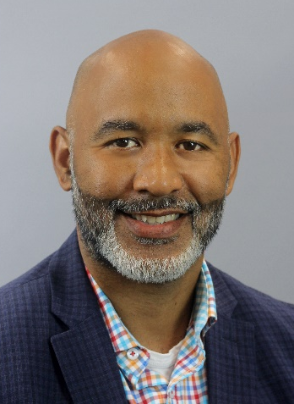



Meet the Team
Western Pennsylvania
Wendy Dunlap
wendy.dunlap@pheaa.org
Armstrong, Beaver, Butler, Clarion, and Lawrence Counties
Kurt Deutsch
kurt.deutsch@pheaa.org
Cameron, Centre, Clearfield, Clinton, Elk, Forest, Jefferson, and Venango Counties
Jonathan Warner
jonathan.warner@pheaa.org
Fayette, Greene, Washington and Westmoreland Counties
William Lindsey
Manager
Amy Sloan
amy.sloan@pheaa.org
Crawford, Erie, McKean, Mercer, Potter, and Warren Counties
Amy Sawdey
amy.sawdey@pheaa.org
Allegheny County
Julie Fontana
julie.fontana@pheaa.org
Bedford, Blair, Cambria, Huntingdon, Indiana, and Somerset Counties
Notes:
Allegheny county staff member needs added.

Slide 4

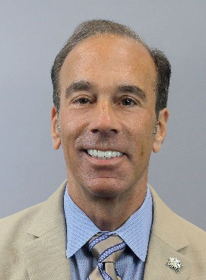






Meet the Team
Eastern Pennsylvania
Diona Brown
diona.brown@pheaa.org
Adams, Cumberland, Franklin, Fulton, and York Counties
Michael Burke
michael.burke@pheaa.org
Carbon, Lehigh,
Monroe, Montgomery, Northampton, and Pike Counties
Tiffanie DeVan
tiffanie.devan@pheaa.org
Dauphin, Juniata, Mifflin, Northumberland, Perry, Schuylkill, Snyder, and Union Counties
Ron Felder
ronald.felder@pheaa.org
Philadelphia County
William Lindsey
Manager
Nancy Harvey
nancy.harvey@pheaa.org
Bradford, Columbia, Lackawanna, Luzerne, Lycoming, Montour, Sullivan, Susquehanna, Tioga, Wayne, and Wyoming Counties
Frances McKeown
frances.mckeown@pheaa.org
Bucks, Delaware and Montgomery Counties
Sonya Mann-McFarlane
sonya.mann-mcfarlane@pheaa.org
Berks, Chester, Lancaster, and Lebanon Counties

Slide 5

Topics
Necessary Things to Consider
Financial Aid Made Simple – 5 Steps
Scholarships
The Free Application for Federal Student Aid (FAFSA®)
Federal and Pennsylvania State Aid
Student and Parent Loans
Financial Aid Notifications
Tips and Strategies
Web Resources

Slide 6
Basic Principles, Federal Aid
Paying is the joint responsibility of the student and parent(s), to the extent possible.
Need-based financial aid is subject to a federal formula to determine financial aid.
Not all families qualify for need-based aid. There is no guarantee that you will get any free money to pay for higher education.

Slide 7

What Is Financial Aid?
Financial aid consists of funds provided
to students and families to help pay for postsecondary educational expenses.
Gift Aid – Grants/Scholarships
Self-Help – Work-Study
Loans

Slide 8

Financial Aid Basics
Financial Aid: funds to help students and families pay the cost of an education at a post-secondary school.
Keep in mind:
Eligibility criteria may apply in order to receive/maintain aid
  Criteria varies based on type/source of aid
  May not qualify for all forms of aid
  Must apply every year to be considered
Students should play an active role in the process
  Research: careers, required training & various schools
  Take advantage of college fairs & school visits (ask about cost and available aid)
  Share goals/plans and ask for assistance, if necessary

Slide 9

Financial Aid Basics
Cost of Attendance(COA):
Costs that the student can expect to incur during a specific school year
Direct costs: billed by the school
Indirect costs: not included in bill but may be incurred
Student Aid Index (SAI)
Used to determine eligibility for need-based aid.
Based on federal formula using information collected from the Free Application From Federal Student Aid (FAFSA)
School costs include:
  Tuition and fees
  Housing & Food
  Books and supplies
  Transportation
  Miscellaneous living expenses
  Childcare, if necessary
Financial Need
Schools will determine need after reviewing financial aid applications
Schools determine aid based on need, eligibility & available funding at their schools

Slide 10
Types of Financial Aid
Page 14; PA Student Aid Guide
GIFT AID: Free Money
  Scholarships: based on merit, unique characteristics and/or need
  Grants: usually based on financial need
SELF HELP AID: Loans, Work Programs, Savings
  Work Study: Student obtains job, often coordinated through the campus and/or State.
    wages earned help cover cost of attendance
    Not offered at all school
  Loans: Borrowed money that must be repaid
Additional sources: 529 plans, tuition payment plans, savings, etc.

Slide 11
Sources of Aid
Federal Government (studentaid.gov)
State Government (pheaa.org)
School or College
Scholarship Organizations

Slide 12
Scholarships
Postsecondary Scholarships
Local and Regional Scholarships
National Scholarships

Slide 13
Scholarship Search
FastWeb.com
Www.sacfoundation.com
Www.tfec.org
Chegg.com
FinAid.org
ScholarshipExperts.com
Scholarships.com
Scholarship-Page.com
DoSomething.org/Scholarships
Colleges.Niche.com
StudentScholarships.org
BigFuture.Collegeboard.org
CollegeAnswer.com
CollegeNet.com
MeritAid.com
MORE….
Start early and search often
Use FREE scholarship search sites
Don’t ignore scholarships with
smaller award amounts
Search for scholarships every year
Pay attention to deadlines!

Slide 14
Federal Student Aid Programs
MUST SUBMIT FAFSA FORM
Federal Program | Program Details | Annual Max Award *
Pell Grant | Awarded to undergraduate students who demonstrate financial need | $7,395
Federal Supplemental Educational Opportunity Grant | Awarded to undergraduate students who demonstrate exceptional financial need | $4,000
Federal Work-Study | Provides jobs for students with financial need, to earn money to help pay school expenses | Determined by School
TEACH | For students who are enrolled in programs designed to prepare them to teach in a high-need field at the elementary or secondary school level | $3,772
Direct Loan | Federal student loan to help cover school expenses (must be repaid) | Ranges from $5,500 to $12,500 per year
Direct PLUS Loan | Federal parent student loan to help cover school expenses (must be repaid) | Up to max school costs minus other aid received
Additional details: Studentaid.gov & SAG p11
Notes:
Max EFC for 23-24 AY = $6,656.

Slide 15
Pennsylvania State Grant
MUST SUBMIT FAFSA & PA STATE GRANT FORMS
Student Aid Guide- pgs. 7-8
PA State Grant: 2023-24 max award $5,750
Awarded to eligible PA residents who demonstrate financial need
Required: approved school/ approved program of study
Out of State schools in DE, MA, OH, WV, VT & DC: max $600
  Veterans: up to $800
Cost Tier | Minimum Award | Maximum Award
$0 - $12,000 | $500 | $3,059
$12,001 - $19,000 | $500 | $4,894
$19,001 - $29,000 | $500 | $5,261
$29,001 - $32,000 | $500 | $5,750

Slide 16
PA State Administered Programs
PA Blind or Deaf Higher Education Beneficiary Grant
Chafee Education and Training Grant Program– co-administered with the PA Department of Human Services
PA Fostering Independence Tuition Waiver Program (FosterEd)
PA National Guard Educational Assistance Grant (EAP)
PA National Guard Military Family Education Program (MFEP)
PA Postsecondary Educational Gratuity Program (PEGP)
PA Partnerships for Access to Higher Education (PATH)
PA State Work-Study - job related to major
PA Student Loan Relief for Nurses (SLRN) Program
PA Targeted Industry Program (PA –TIP)
PA Ready to Succeed Scholarship (RTSS)

Slide 17

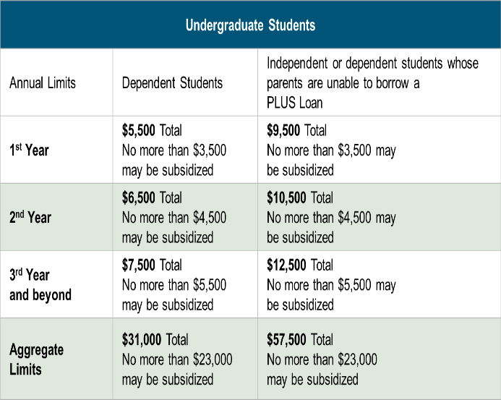
Federal Direct Loans
Loan is in student’s name
Max. borrowing limits
May receive a Direct Subsidized and/or Direct Unsubsidized loan
Fixed rate: set July 1st for 1st time borrowers
Origination fee
Deferred payments
Must complete the FAFSA
Must complete entrance counseling & MPN
Notes:
4.99 & 1.057
7.54 & 4.228

Slide 18

Additional Student Loans
Federal PLUS Loans
Private Loans
Loan is in the parent’s name
Must meet credit requirements
  May apply with a credit worthy cosigner
  If denied, student may borrow additional unsubsidized amount
May borrower up to the COA minus any other aid
Fixed interest rate: set July 1 for 1st time borrowers
Origination fee
Payments may be deferred
Student must complete the FAFSA
Loan is in the student’s name (cosigner is generally required)
Student or Cosigner must meet income & credit requirements
May borrower up to the COA minus any other aid
Variable or fixed interest rate
May have cosigner release clauses
Terms vary by lender
  Do your research
  Read the fine print

Slide 19

PA’s Low-Cost Way
to Pay for College!
Low, Fixed Rates
Learn more at PHEAA.org/PAForward
1) Annual Percentage Rate (APR) Calculations – The lowest APR is based on the following assumptions: a loan of $10,000 made in a single disbursement, a student borrower who selected an Immediate Repayment Plan and a repayment term of 120 months, monthly payments of $100.87 and a final payment $78.29, a fixed periodic interest rate of 4.17%, and a total amount financed of $11,980.40. The student borrower in this sample qualified for a 0.25% Direct Debit benefit for the entirety of the repayment period and a 0.50% graduation benefit was applied 47 months into repayment. The highest APR is based on the following assumptions: a loan of $10,000 made in a single disbursement, a student borrower who selected a Fully Deferred Repayment Plan and a repayment term of 180 months, monthly payments of $117.93, a fixed periodic interest rate of 7.07%, and a total amount financed of $21,227.72. The student borrower received an in-school deferment of 46 months and a grace period of 6 months. The student borrower in this sample did not qualify for any interest rate discounts. These APRs are estimates and may differ from the actual rates received.
2) The provided rate range includes Undergraduate, Graduate, and Parent loans and may change based on loan type, loan term, repayment plan, and applicable discounts (not all discounts apply to all loan products). See individual loan programs for more specific information. PHEAA uses applicant credit scores to determine eligibility and interest rates. Higher credit scores may mean an applicant is offered a lower interest rate.
Applicants, including co-signers, are subject to credit qualifications, completion of an application and credit agreement, and verification of application information. PHEAA uses applicant(s) FICO score(s) to determine eligibility and interest rates. Higher credit scores may mean an applicant is offered a lower interest rate.
PHEAA reserves the right to discontinue all programs or benefits without prior notice.

Slide 20

Be a Smart Borrower
Exhaust all free financial aid options before borrowing student loans
Seek federal student loans before private student loans
Only borrower the amount needed (loans must be repaid)
Do your research!
MySmartBorrowing.org: An interactive, online tool created by PHEAA that helps students and families:
  Estimate career, salaries & college tuition
  View the impact of savings on overall cost
  Calculate loan repayment
  Avoid borrowing too much money
Select a
Career
Factor in Savings
Select a School
Get Results

Slide 21
The Application Process

Slide 22

Financial Aid Forms
Know which forms are required by each school
All Schools Require:
Free Application for Federal Student Aid (FAFSA)
    Required by PHEAA, and some scholarship organizations as well
PA State Grant Form (SGF) through PHEAA
    Required for first -year students
    Link from the FAFSA form or apply at www.pheaa.org
Some Schools Require:
CSS Profile (College Scholarship Service)
  https://student.collegeboard.org/css-financial-aid-profile
Institutional Financial Aid Forms
  Internal forms specific to each school
  Required by some schools

Slide 23

Free Application for Federal Student Aid (FAFSA®)
2024-25 FAFSA® is New & Improved!
New redesigned form available December 2023
FAFSA has less questions & more user friendly than previous version
IRS Direct Data Exchange (DDX) replaces the IRS Data retrieval tool:
  Import Federal Tax Information (FTI) from the IRS or
  Confirm non-filing status (if not required to file taxes)
Student & required contributors must:
  Have their own Federal Student Aid Accounts (FSA ID)
  Provide consent for FSA to retrieve & disclose federal tax information
Student Aid Index (SAI) replaces the Expected Family Contribution (EFC)
Students can list more colleges & career schools on the form
Family size Is based number of exemptions on tax return (may be modified if number has changed)

Slide 24
Free Application for Federal Student Aid: FAFSA
Important!
All students who wish to be considered for financial aid & plan to attend an approved post-secondary school must complete the form.
Complete the correct FAFSA (2024-25 AY)
Federal, state & school deadlines exist: File BEFORE the earliest deadline
Check the Student Aid Guide p.20 for PA State deadlines
Enrollment Dates (year student will attend college or career school) | When can students submit the FAFSA | Tax Return Information
July 1, 2023 - June 30, 2024 | October 1, 2022 – June 30, 2024 | 2021
July 1, 2024 - June 30, 2025 | December 2023 – June 30, 2025 | 2022
July 1, 2025 - June 30, 2026 | October 1, 2024 – June 30, 2026 | 2023

Slide 25

Federal Student Aid Accounts (FSA ID)
Information Needed for 2024-25 FAFSA
Social Security Number
Username
Email Address
Password
Mobile Phone
Security Questions
Enable Two-Step Verification
The student applying and all required contributors to the FAFSA must create an FSA ID.
Create account at FSA ID at studentaid.gov/fsa-id.
Create 3 - 4 days prior to completing the FAFSA.
Student & all required contributors need FSA IDs
Legal signature on FAFSA & PA State Grant forms.
Requires a valid email account for each user
Users without an SSN will be able to acquire an FSA ID

Slide 26
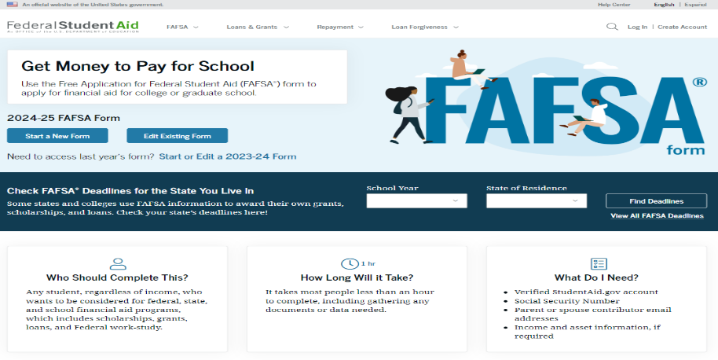
Free Application for Federal Student Aid (FAFSA®)
FAFSA® - primary form to apply for aid
used to determine student eligibility for:
  Federal & state programs
  Some school programs
  Some scholarship programs
File annually (beginning Sr. year in high school)
File online at studentaid.gov
Free to file

Slide 27

Information Needed for 2024-25 FAFSA
Student Aid Guide- p. 18
Social Security Numbers
Email Addresses (Not high school email address)
2022 Federal Tax Returns and W-2’s
Current bank statements and records of other investment accounts (as of the FAFSA filing date including farm value and value of small business)
Student & Contributor(s)
Federal Student Aid
Account FSA ID
Current Records of any stocks, bonds and other investments, including 529 for student for whom the FAFSA is being completed
Total child support received from the most recently complete calendar year

Slide 28
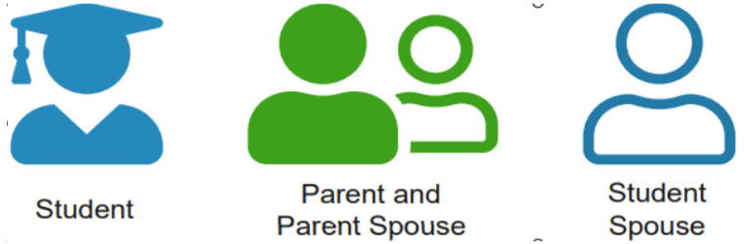
Roles Within the 2024-25 FAFSA
Answers on FAFSA determine which contributors will be required to provide information
Student invites contributors to complete their portion of the form
  Required: Name, date of birth, SSN and email address
Contributors are not financially responsible for student’s education costs

Slide 29
FAFSA Steps
Personal Circumstances
Demographics
Financials
Colleges
Signature
5 key sections on the 24-25 FAFSA
Student & contributors complete their own sections using their respective FSA ID accounts
Student completes all sections
Contributors (parents) completes (demographics, financials & signature)
Onboarding steps, wizards and help tools to guide students & contributors
Form is not complete until all required signatures are submitted

Slide 30
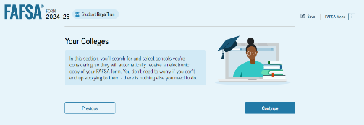
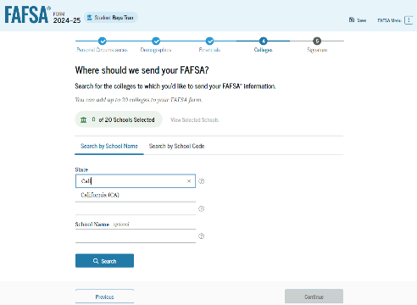
FAFSA – Colleges Section
  Only schools listed will receive results of FAFSA
  Don’t have to have applied/been accepted to list school
  Can list up to 20 schools at a time
  May go back and add schools later
NOTE: Once your Final Decision is made, Update your PA Grant Information with the school you WILL attend.

Slide 31
Whose Information is reported on the 2024-25 FAFSA?
Dependent student & legal parent(s)
  Biological/adoptive parents living together (married/unmarried)
  Divorced or separated parents
    The parent that provided the most financial support to student over the past 12 months (if remarried, spouse)
    If equal, the parent with the higher income
Independent student- student’s information only (and spouse, if married)
Do NOT include:
Foster Parents
Legal Guardians
  By court order
Anyone else living with the student

Slide 32

Who Is Independent?
Born before January 1, 2001
Married (and not separated)
Veteran (includes active-duty personnel)
Working on graduate level degree
Parent’s information is not required
Emancipated minor
Legal guardianship
Anytime since the age of 13 has been either:
  An orphan,
  In foster care
  Ward of the court
Have legal dependents other than spouse
Student unaccompanied and homeless or self-supporting and at risk of being homeless

Slide 33
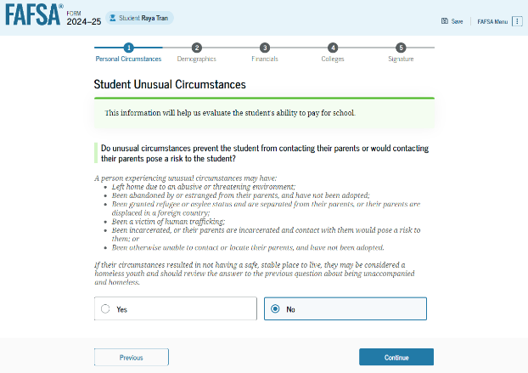
Provisional Independent Status
Provisional independent status is granted to students with unusual circumstances & as a result:
student can complete FAFSA without providing parental information
Student will receive an estimate of their federal student aid eligibility
Financial aid administrator will make the final determination of the unusual circumstances
  Based on documentation received from student
  Personal assessment of the financial aid administrator
If approved, student’s unusual circumstances remain as long as student remains at that school and circumstances do not change.

Slide 34

Financial Information:
Student Aid Guide- p. 18
Income: 2022 Income information is required for the 2024-25 FAFSA form.
DDX may not work for everyone: enter information manually if cannot use it
Assets: If required to report assets:
Report the net value of assets, as of the day you are completing the FAFSA.
  Balance of checking & savings accounts, records of stocks, bonds, bitcoins, etc.
  Value of 529 accounts for the student owned by the parent(s) of a dependent applicant or owned by the student applicant
  Child support received for the most recently completed calendar year
  Net Worth of your businesses or for-profit agricultural operations.
Do not report the value of:
  Primary home
  Qualified retirement funds
  Life insurance policies

Slide 35
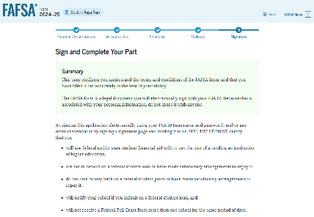
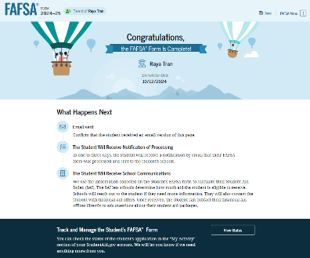
Signing with the FSA ID
FAFSA must be signed by Student & all required contributors before it is considered complete.
If parent submits the FAFSA, then student will receive an email and can access the detailed confirmation page.

Slide 36
FAFSA Confirmation
Visit pheaa.org/StudentAid after completing the FAFSA
All data corrections (for example, school choice) will need to be made on the FAFSA
  PHEAA will receive the updated information
  First school listed on FAFSA is used for PA State Grant eligibility purposes
FAFSA information will be automatically sent to PHEAA
  Initial transfer will not happen until February 2024
  Following this, transfers will happen in 7 business days after you've completed the FAFSA

Slide 37
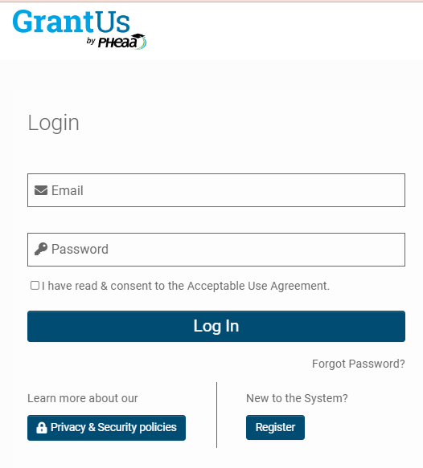
GrantUs
Replaces Account Access as PHEAA’s PA State Grant and Special Programs online account management tool
Launching for students in early 2024 for the 2024-25 Award Year
  Prior periods will be housed in Account Access
Will be used to apply and manage eligibility for PA State Grant Program and the special programs administered by PHEAA (e.g., PA Targeted Industry Program, Chafee Education and Training Grant Program, etc.)

Slide 38
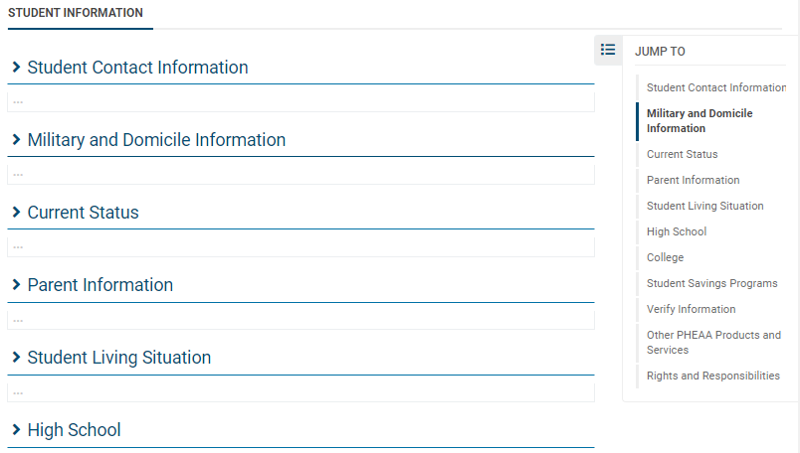
PA State Grant Form (SGF)
Students able to complete SGF after PHEAA receives FAFSA information
  Information typically transmitted to PHEAA in 3-5 business days
  SGF cannot be completed prior to completing FAFSA
GrantUs account will need to be set up to complete SGF
  Email to create an account will come from noreply@grantus.pheaa.org
  Student will invite parent to create an account if parental data is required to determine eligibility

Slide 39
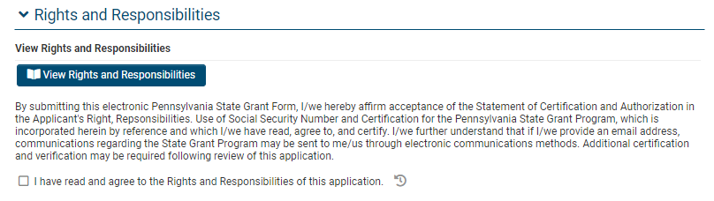
PA State Grant Form (SGF)
Check the Rights and Responsibilities Box to sign the SGF

Slide 40

Special Circumstances
**not the same as “unusual circumstances”
If things change…
Divorce or separation
Recent death or disability
Reduced income/Unemployment
Excessive medical expenses
Contact schools listed on FAFSA: Only a school can change a FAFSA based on your circumstances
Contact PHEAA for the PA State grant

Slide 41
Forms are Filed – Now What?

Slide 42

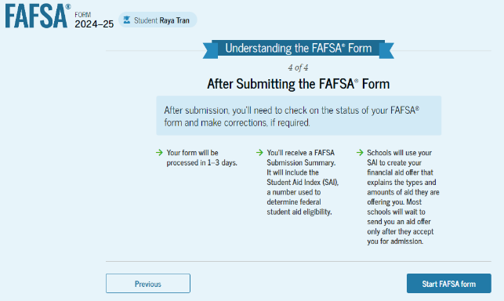
The Process Continues
After the FAFSA is filed:
Monitor emails & respond to requests from Federal Student Aid, PHEAA & schools.
Student receives FAFSA Submission Summary
Student Aid Index (SAI) is included on the FAFSA Submission Summary
  Schools use SAI to create financial aid offers
FAFSA describes next steps

Slide 43

Need Analysis
Cost of Attendance…………………..........… $29,000
  - Student Aid Index (SAI)…….……………... - $4,000
  Other Financial Aid (OFA).......................... -$3, 000
  = FINANCIAL NEED ……………………...... = $22,000
FAO “awards” students based on financial need and available funding (varies by school)
Financial Aid Notification is sent to the student after they have applied & been accepted.
  Lists types, sources and amount of aid
  Describes what must be done to accept or reject
  Review carefully!
Cost of Attendance
- EFC
= Financial Need

Slide 44
Compare & Understand Financial Aid Offers
Do you understand your actual costs?
  Cost of Attendance
  Out of pocket costs
  Do you have other children’s education costs to consider?
  If necessary, are you willing to commit to loans for your student’s education?
Have you made an affordable choice of school?
Students and parents should talk about what they can afford to pay.
How much of the financial aid is free money?
Which awards are based on need, and which are based on merit?
Are there any conditions on the free money? GPA requirement?
Will awards increase as tuition increases?
Will awards change from year to year?
Will loans be needed?

Slide 45


Resources
Federal Student Aid Information Center
  Email, call or chat with customer service agents
  Phone: 800-433-3242 (800-4-FED AID)
  Websites: Studentaid.gov & collegecost.ed.gov
PHEAA
  Email: granthelp@pheaa.org
  Phone: 800-692.7392
  Website: PHEAA.org
    MySmartBorrowing.org
    Educationplanner.org
Financial Aid Offices

Slide 46
Resources
Higher Education Access Corner
Higher Education Access Corner provides candid conversations around higher education access and affordability. Tune in to hear a variety of engaging discussions with industry professionals, as well as how PHEAA helps create affordable access to higher education.
Subscribe and listen on your favorite podcast app or streaming platform.
Available on Spotify, Google Podcasts, iHeartRadio, Amazon Music and more
Available on PHEAA’s YouTube channel (PHEAA Financial Aid).

Slide 47

PHEAA Publications

Slide 48
QUESTIONS?

Slide 49
Your Presenter
Ronald Felder
Higher Education Access Partner
Philadelphia Region
PA Higher Education Assistance Agency (PHEAA)
267-294-8204
Ronald.Felder@pheaa.org
Notes:
To be revised by each Access Partner

